Slide 1
Outline of Today’s Discussion
Introduction to Correlation
An Alternative Formula for the Correlation Coefficient
Coefficient of Determination

Slide 2
Part 1
Introduction To Correlation:
Linear Case

Slide 3

Correlation
Some context for correlation - the big picture:
2. Understanding
3. Prediction
1. Creating
Change
4. Description
The “Fab Four” of the Scientific Method
“Imagine” a world that worked like this.

Slide 4

Correlation
Some context for correlation - the big picture:
3. Understanding
2. Prediction
4. Creating
Change
1. Description
The “Fab Four” of the Scientific Method
The scientific world really works like this.

Slide 5
Correlation
From research methods, here are some necessary (but not sufficient) conditions for “understanding” – identifying causal relations between variables.
A. Correlation!
B. Time Order Relation (causes precede effects)
C. Plausible Alternatives Are Eliminated
2. So, we’ll start a new with correlation…

Slide 6
Correlation
So far this semester we’ve focused mainly on description.
Descriptive stats include some measure of central tendency, and some measure of dispersion.
Prediction –and correlation- will be require slightly more complexity…and will be less parsimonious!
Potential Pop Quiz Question: What is parsimony, and what is Ockham’s razor? (Hint: Look on the web, not in your text.)

Slide 7
Correlation
When data are well described by ONE mean alone, we have a parsimonious description (one parameter does the trick).
Hypothesis testing and Parsimony – Can a single mean accurately describe the experimental group and the placebo/control group?
If yes, two separate means would violate parsimony.
If no, then the additional complexity (i.e., having 2 means, not just 1) may be justified.

Slide 8
Correlation
One type of association involves (linear) prediction: y = mx + b
So there is more than just a mean –we’ll need an equation.
In that sense, “complexity” has increased.

Slide 9
Correlation
Here’s another distinction…our first section focused on differences.
Example: Is the mean mean of the Atkins group different than that of the Low-fat-diet group.
In this section of the course, we’ll look for (linear) associations between variables –not differences!

Slide 10
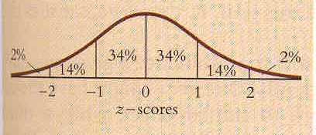
Correlation
Another distinction is in graphing
We’ve previously used frequency distributions, and plots of DVs as a function of IVs.
Now, for correlation we’ll use scatter plots…

Slide 11
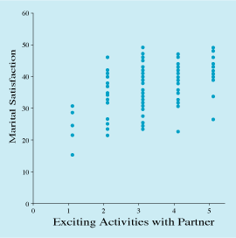
Correlation:
Graphing & The Scatter Diagram
Scatter diagram
  Graph that shows the degree and pattern of the relationship between two variables
Horizontal axis
  Usually the variable that does the predicting
    e.g., price, studying, income, caffeine intake
Vertical axis
  Usually the variable that is predicted
    e.g., quality, grades, happiness, alertness

Slide 12
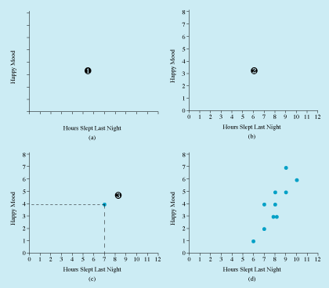
Correlation:
Graphing & The Scatter Diagram
Steps for making a scatter diagram
  1. Draw axes and assign variables to them
  2. Determine the range of values for each variable and mark the axes
  3. Mark a dot for each person’s pair of scores

Slide 13
Correlation
A statistic for describing the relationship between two variables
  Examples
    Price of a bottle of wine and its quality
    Hours of studying and grades on a statistics exam
    Income and happiness
    Caffeine intake and alertness

Slide 14
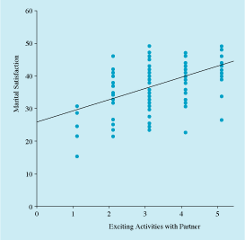
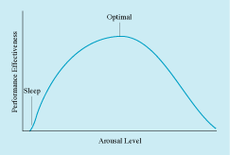
Correlation
Linear correlation
  Pattern on a scatter diagram is a straight line
  Example above
Curvilinear correlation
  More complex relationship between variables
  Pattern in a scatter diagram is not a straight line
  Example below

Slide 15
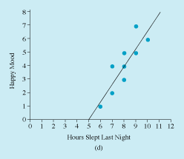
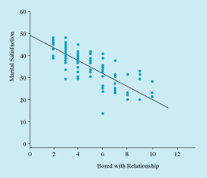
Correlation
Positive linear correlation
  High scores on one variable matched by high scores on another
  Line slants up to the right
Negative linear correlation
  High scores on one variable matched by low scores on another
  Line slants down to the right

Slide 16
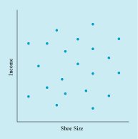
Correlation
Zero correlation
  No line, straight or otherwise, can be fit to the relationship between the two variables
  Two variables are said to be “uncorrelated”

Slide 17
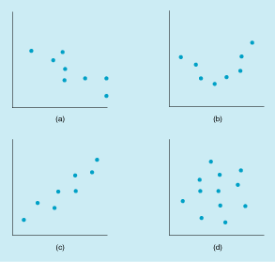
Correlation Review
a. Negative linear correlation
b. Curvilinear correlation
c. Positive linear correlation
d. No correlation

Slide 18
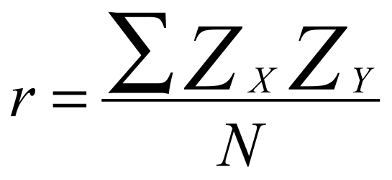
Correlation Coefficient
Correlation coefficient, r, indicates the precise degree of linear correlation between two variables
Computed by taking “cross-products” of Z scores
  Multiply Z score on one variable by Z score on the other variable
  Compute average of the resulting products
Can vary from
  -1 (perfect negative correlation)
  through 0 (no correlation)
  to +1 (perfect positive correlation)
We will soon
see an alternate
equation for the
correlation coefficient

Slide 19
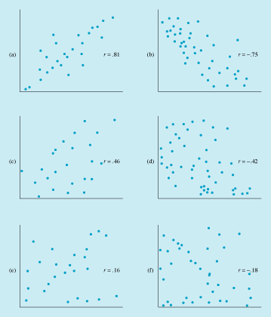
Correlation Coefficient Examples
r = .81
r = -.75
r = .46
r = -.42
r = .16
r = -.18

Slide 20
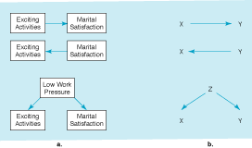
Correlation and Causality
When two variables are correlated, three possible directions of causality
  1st variable causes 2nd
  2nd variable causes 1st
  Some 3rd variable causes both the 1st and the 2nd
Inherent ambiguity in correlations

Slide 21
Correlation and Causality
Knowing that two variables are correlated tells you nothing about their causal relationship
More information about causal relationships can be obtained from
  A longitudinal study—measure variables at two or more points in time
  A true experiment—randomly assign participants to a particular level of a variable

Slide 22
Statistical Significance of a Correlation
Correlations are sometimes described as being “statistically significant”
  There is only a small probability that you could have found the correlation you did in your sample if in fact the overall group had no correlation
  If probability is less than 5%, one says “p < .05”
  Much more to come on this topic later…

Slide 23
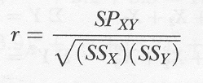
Part 2
Alternate Formula For
The Pearson
Correlation Coefficient

Slide 24
Part 3
Coefficient of Determination

Slide 25
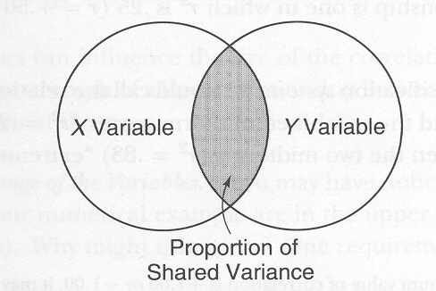
Coefficient of Determination
Researchers often use the “r-squared” statistic, also
called the “coefficient of determination”, to describe
the proportion of Y variability “explained” by X.

Slide 26
Coefficient of Determination
What range of values is possible for the
coefficient of determination (the r-squared statistic)?

Slide 27
Coefficient of Determination
Example: What is the evidence that IQ is heritable?

Slide 28
Coefficient of Determination
R-value for the IQ of
identical twins reared apart = 0.6.
What is the value of r-squared in this case?

Slide 29
Coefficient of Determination
So what proportion of the IQ is
unexplained (unaccounted for) by genetics?

Slide 30
Coefficient of Determination
Different sciences are characterized by
the r-squared values that are deemed impressive.
(Chemists might r-squared to be > 0.99).

Slide 31
Coefficient of Determination
We will soon learn that r-squared
in SPSS is called “eta-squared”.
Questions?

Slide 32
Proportion of Variance
Accounted For
Correlation coefficients
  Indicate strength of a linear relationships
  Cannot be compared directly
  e.g., an r of .40 is more than twice as strong as an r of .20
To compare correlation coefficients, square them
  An r of .40 yields an r² of .16; an r of .20 an r² of .04
  Squared correlation indicates the proportion of variance on the criterion variable accounted for by the predictor variable

Slide 33
